Slide 1
APR 2022 Update
10 May 2022

Slide 2
Cautionary note regarding forward-looking statements
All statements contained in this report that are not statements of historical fact constitute “forward-looking statements”. Some of these statements can be identified by forward-looking terms, such as “anticipate”, “believe”, “can”, “could”, “estimate”, “anticipate”, “project”, “expect”, “intend”, “may”, “plan”, “aim”, “will” and “would” or similar words. However, these words are not the exclusive means of identifying forward-looking statements. All statements regarding our expected financial condition and results of operations, business, plans and prospects are forward-looking statements. These forward-looking statements include statements as to our business strategy, revenue and profitability (including, without limitation, any financial or operating projections or forecasts), planned projects and other matters discussed in this document regarding matters that are not historical fact. These forward-looking statements and any other projections contained in this report involve known and unknown risks, uncertainties and other factors that may cause our actual financial results, performance or achievements to be materially different from any future financial results, performance or achievements expressed or implied by such forward-looking statements or other projections.
Forward-looking statements are based on our beliefs and assumptions, which in turn are based on currently available information. Our outlook is predominantly based on our interpretation of what we consider to be the key economic factors affecting our business, the global economy and the sectors we operate in. Although we believe the assumptions upon which these forward-looking statements are based are reasonable, any of these assumptions could prove to be inaccurate, and the forward-looking statements based on these assumptions could be incorrect. Actual results may differ materially from information contained in the forward-looking statements as a result of a number of factors, many of which are beyond our control. Accordingly, investors are cautioned not to place undue reliance on the forward-looking statements in this report. These statements speak only as of the date of this report or the respective dates indicated in this report, and we undertake no obligation to update or revise any of them, whether as a result of new information, future events or otherwise.

Slide 3
Table of contents
Financials and Outlook 4
Event Highlights 7
News Clipping 13
We have a traditional wooden house at all of our major locations for employees meetings and social events.

Slide 4
Financials and Outlook

Slide 5
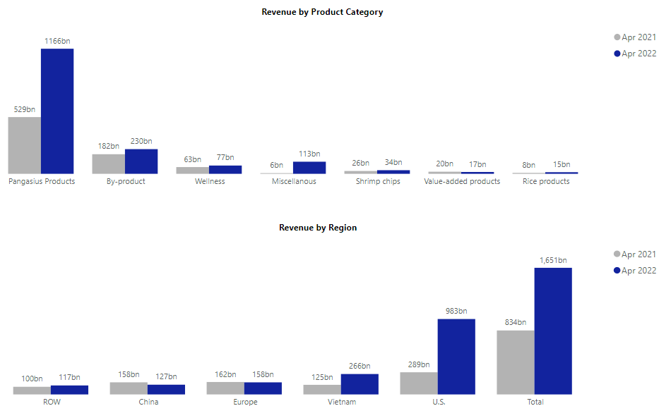
APR 2022 Revenue dashboard – Yoy
+121%
Total revenue increased by 98% YoY primarily due to the growth in these respective product categories: Pangasius Products (+121% YoY), By-products (+26% YoY), Wellness (+23% YoY), and Miscellaneous (+1712% YoY), Shrimp chips (+29% YoY), and Rice products (+23%); partly offset by Value-added products (-13% YoY)
Revenue growth is seen across the U.S. (+240% YoY), ROW (+18% YoY), and Vietnam (+112% YoY); partly offset by China (-20% YoY), and Europe (-3% YoY)
+26%
+23%
+1712%
+29%
-13%
+23%
+98%
+240%
+18%
-20%
-3%
+112%
Source: Management; Note: rounded preliminary figures not audited or reviewed in VND billions; figures presented in net revenue basis, net of sales return and deduction; ROW denotes Rest of World (incl. HK)

Slide 6
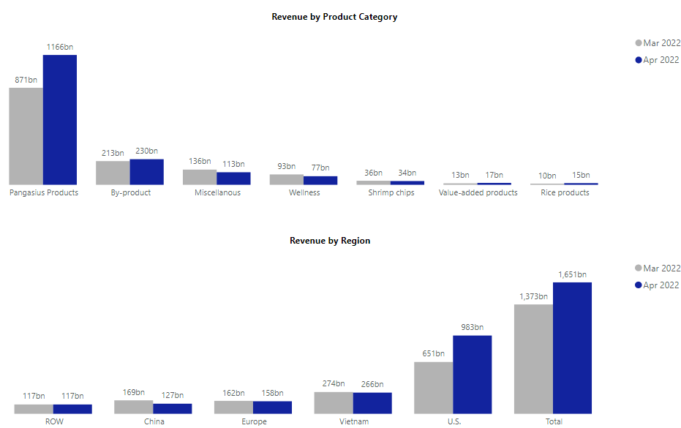
APR 2022 Revenue dashboard – MOM
+34%
Total revenue increased +20% MoM due to the increase in all Pangasius Products (+34% MoM), By-product (+8% MoM), Value-added products (+30%), and Rice products (+43% MoM); partly offset by Miscellaneous (-17% MoM), Wellness (-17% MoM), and Shrimp chips (-8%% MoM),
The increase is mainly coming from the U.S. market (+51% MoM); partly offset by China (-24% MoM), Europe (-3% MoM), ROW (-0% MoM), and Vietnam (-3% MoM)
+8%
-17%
-17%
-8%
+30%
+43%
+20%
+51%
-3%
0%
-24%
-3%
Source: Management; Note: rounded preliminary figures not audited or reviewed in VND billions; figures presented in net revenue basis, net of sales return and deduction; ROW denotes Rest of World (incl. HK)

Slide 7
EVENT HIGHLIGHTS

Slide 8
EVENT HIGHLIGHTS
On April 20, 2022, Vinh Hoan Corporation (VHC) held its Annual Shareholders Meeting at GEM Center
Apr 2022, Vietnam

Slide 9
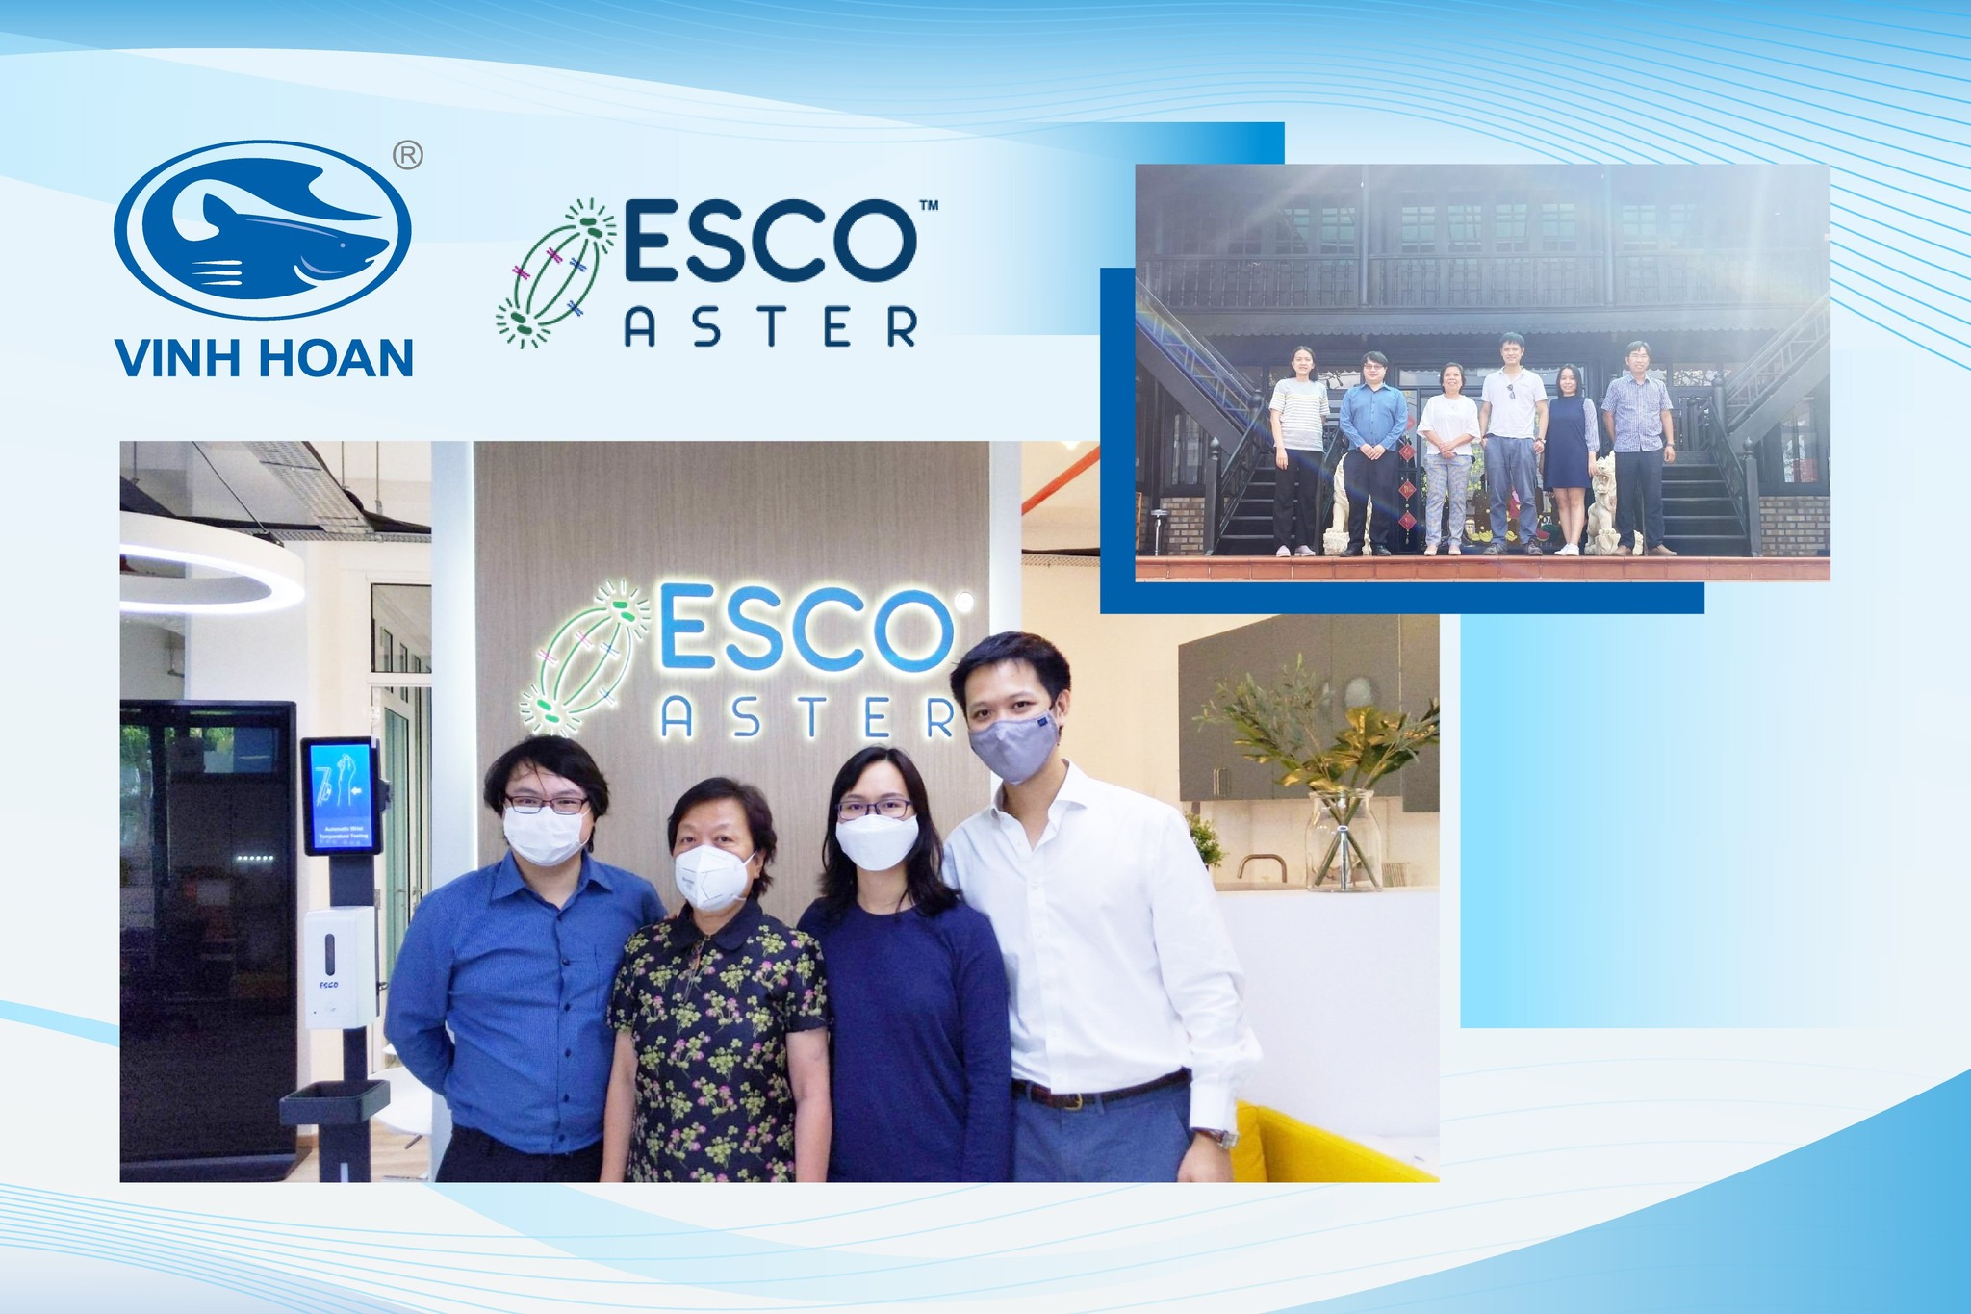
EVENT HIGHLIGHTS
ESCO ASTER team had an exciting visit to Vinh Hoan’s farm with Madam Khanh – Founder and Chairwoman, Ms. Hue Ho – Chief Production Officer, and Mr. Vinh Nguyen – Deputy Production Director.
Apr 2022, Vietnam

Slide 10
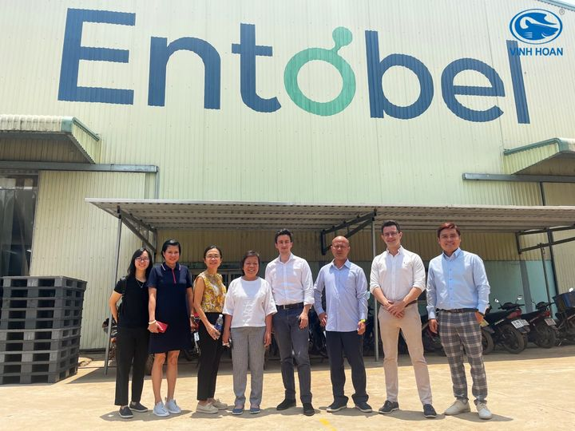
EVENT HIGHLIGHTS
Madam Khanh – Founder and Chairwoman, Mrs. Tam Nguyen – CEO, Mrs. Diep Lam – Director of FeedOne, and Mr. Duc Vo - Director of Vinh Hoan Collagen had an exciting visit to the Entobel factory.
28 Apr 2022, Vietnam

Slide 11
EVENT HIGHLIGHTS
The Shiok Meats team who had visited Vinh Hoan’s factories in Cao Lanh City, Dong Thap province. Shiok Meats is a company Vinh Technology invested in specializing in cultivated crustaceans the first of its kind in Singapore and South-East Asia.
Apr 2022, Vietnam

Slide 12
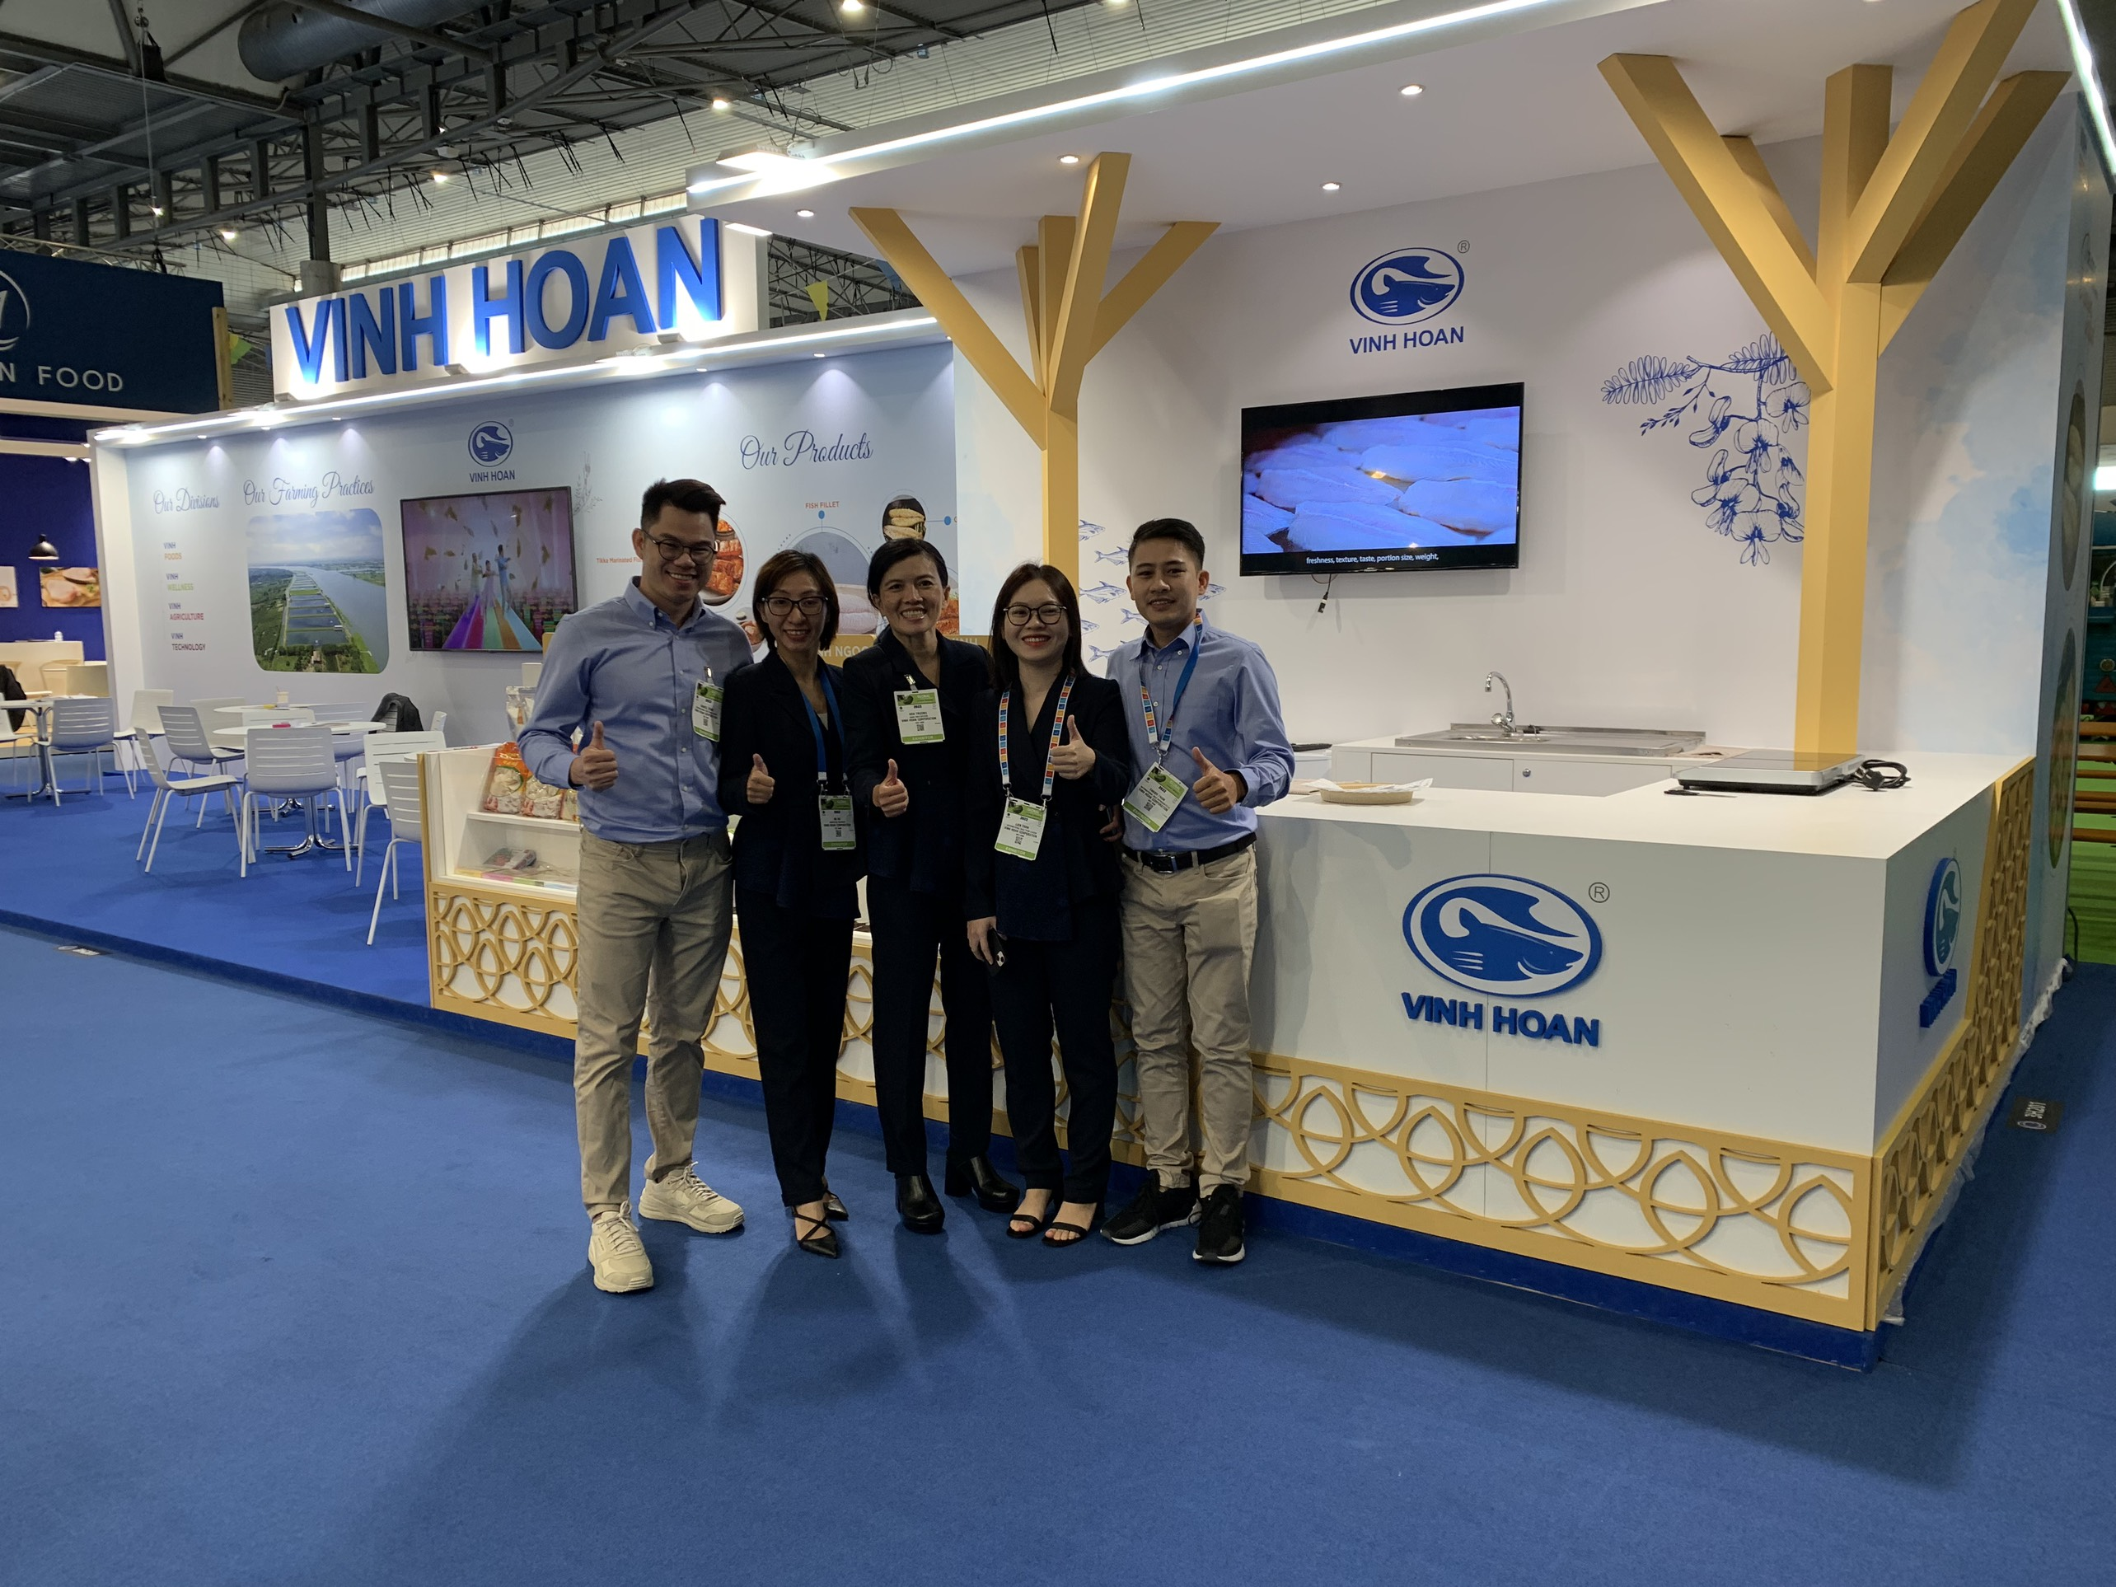
EVENT HIGHLIGHTS
Ms. Hoa Truong – Chief Sales Officer, and representatives of Vinh Hoan Corporation, participated in Seafood Expo Global 2022 and showcased our products and innovations in aquaculture and agriculture.
Apr 2022, Vietnam

Slide 13
NEWS CLIPPING

Slide 14
NEWS clipping
The Federal Service for Veterinary and Phytosanitary Supervision (FSVPS) officially added Vinh Hoan Corporation to the list of permitted companies exporting to the Eurasian Economic Union (EEU)
“FSVPS officially issued the written notice that Hung Ca Co., Ltd (DL 126) and Plant 3 – Vinh Hoan Corporation (DL 500) are added to the list of permitted companies exporting to the Eurasian Economic Union (EEU) since May 4th, 2022”
04 May 2022
After two year pent-up demand, pangasius exports are expected to explode
“…
After being affected by the industry downturn (2019) and two years of being affected by diseases and broken supply chains (2020 - 2021), BSC (BIDV Securities Company) believes that the pangasius industry will enter an uptrend in 2022. BSC believes that the demand for pangasius in key markets such as the US, China and the EU will grow strongly after a long suppression by COVID-19 and the vaccine coverage rate is over 60% of the population.
…
In addition, the sanctions banning seafood imports from Russia by Western countries is expected to increase the demand for alternative seafood products from other countries (including Vietnam) in markets. US and EU.
…”
VASEP, 20 Apr 2022
China’s middle class increasingly choosing seafood as pork consumption declines
“…
Pork has long been considered the bedrock protein of the Chinese diet, and is typically cheaper than seafood. With price being a primary motivator for Chinese consumers, seafood has often lost out, but the correlation between the two appears to have become unhitched as the average Chinese income has risen, giving more consumers the ability to choose seafood as a healthier dietary option.
…
The eclipsing of pork by seafood has prompted a surge in interest in seafood stocks among the country’s many retail investors, who have also watched as the Chinese government has issued numerous policies to support the continued growth of the country’s aquaculture and distant-water fishing operations.
…”
SeafoodSource, 18 Apr 2022

Slide 15
Thank you
If you have any questions or would like to subscribe to our monthly newsletter, please contact Investors Relation Department at ir@vinhhoan.com.

